Slide 1
Mental Toughness
Helena Sharpstone and Caryn Skinner

Slide 2
The session
What is it?
What’s in it for you to be mentally tough?
What does it look like?
Creating the right environment
When does it come in handy?
How to switch off when you need to

Slide 3
The session
What is it?
What’s in it for you to be mentally tough?
What does it look like?
Creating the right environment
When does it come in handy?
How to switch off when you need to

Slide 4
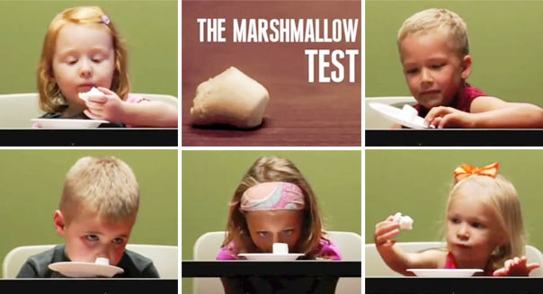

Slide 5
What is Mental Toughness?
Keeping strong in the face of adversity.
Keep your focus and determination
Events don't throw you off your game.
Tenacity to learn from your mistakes
Keep emotions in check

Slide 6
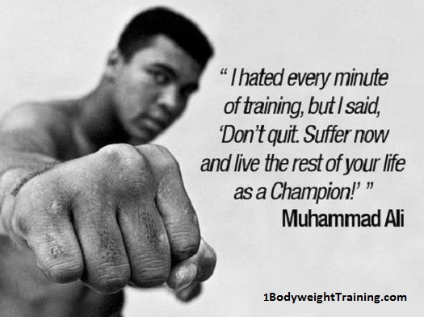
It is the voice in the back of your head that tells you to keep going, keep pushing, and keep trying, even when the going gets tough.

Slide 7
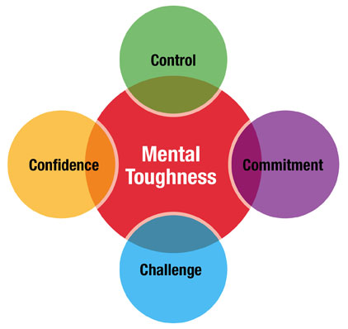
Mental Toughness

Slide 8
Main features
Ordinary
Cannot avoid emotional distress
It can be learned

Slide 9
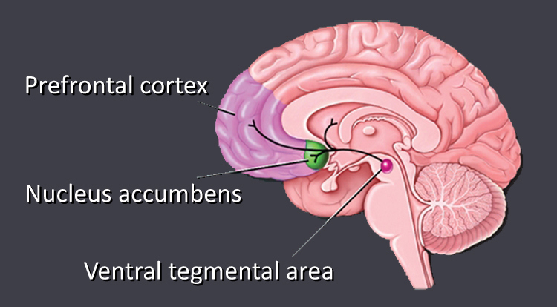

Slide 10
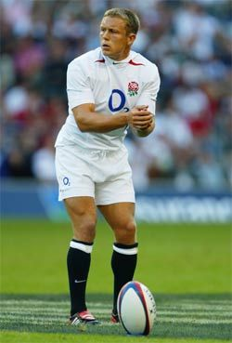
“The more I practise the luckier I get”
Gary Player

Slide 11
The session
What is it?
What’s in it for you to be mentally tough?
What does it look like?
Creating the right environment
When does it come in handy?
How to switch off when you need to

Slide 12
Higher performance
Emotional wellbeing
Psychological health
Physical health

Slide 13
The session
What is it?
What’s in it for you to be mentally tough?
What does it look like?
Creating the right environment
When does it come in handy?
How to switch off when you need to

Slide 14
What does it look like?

Slide 15
People who have it
Welcome challenge
Strong commitment
Personal control
Optimism
Isolate negative events
Look at themselves constructively
Future focussed
Tolerance for ambiguity
Thrive on change
Create solid goals
Empathy for others
Form strong relationships

Slide 16
People who have it
Self evaluate
Use feedback intelligently
Welcome feedback
Accept they will fail sometimes
Learn lessons
Don’t get stuck in negative patterns
Change habits
Collaborate
Take responsibility for their actions
Get enough sleep
Value and protect “me time”
Keep learning

Slide 17
The session
What is it?
What’s in it for you to be mentally tough?
What does it look like?
Creating the right environment
When does it come in handy?
How to switch off when you need to

Slide 18
Creating the right environment
The capacity to make realistic plans and take steps to carry them out
A positive view of yourself and confidence in what you have to offer
Strong communication skills
Problem solving abilities
The capacity to manage emotions and stress

Slide 19
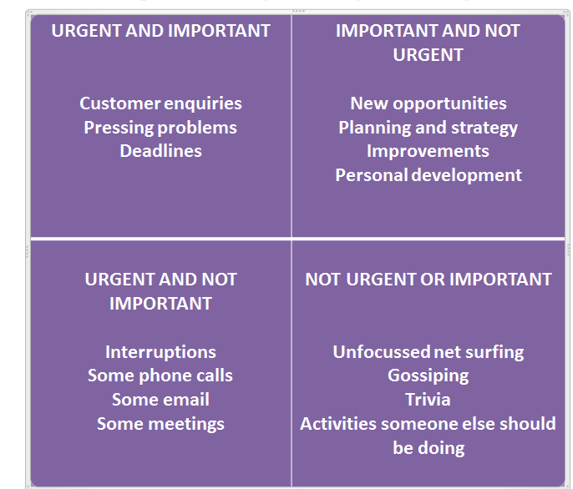
The capacity to make realistic plans and take steps to carry them out
Prioritising
Allow planning time
“Energy lists”
Bravery in the face of changing priorities

Slide 20
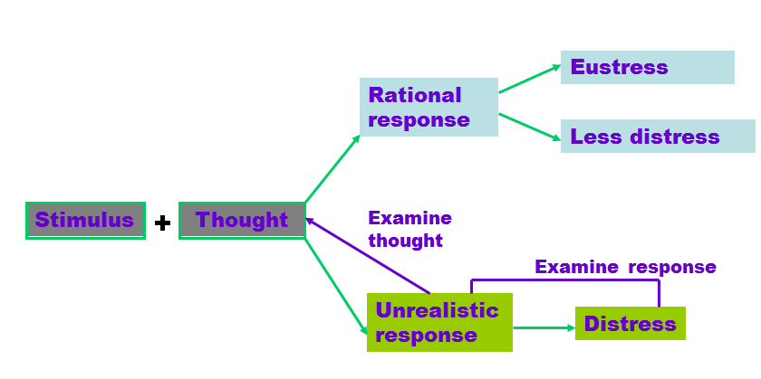
A positive view of yourself and confidence in what you have to offer
Encourage skills audits
Discourage black and white thinking
Practise thought reframing
Identify and challenge sources of negativity

Slide 21
Strong communication skills
Promote the power of listening
Identify different styles of influence
Encourage more pitching/public speaking/presenting
Challenge existing media – what is the best way?
Adopt a flexible style
Get feedback

Slide 22
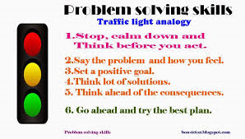
Problem solving abilities

Slide 23
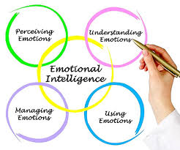
The capacity to manage emotions and stress
Get your own house in order
Remember stress is an inside job
Think of ways to encourage balance
Encourage consistent, calm and reasonable behaviour

Slide 24
The session
What is it?
What’s in it for you to be mentally tough?
What does it look like?
Creating the right environment
When does it come in handy?
How to switch off when you need to

Slide 25
Ambiguity
My ‘Yippee!’ is your ‘Oh no!’

Slide 26
Emotional Response
Sad
Mad
Wary
Glad
Notes:
Please zapp this up

Slide 27
Ambiguous situations can be defined as:
Completely new situations
Complex situations
Apparently insoluble situations

Slide 28
Ways to tolerate and manage ambiguity effectively - Shift gears/change course quickly and easily - Decide and act without having the total picture - Tolerate situations where things are up in the air - Move between tasks and activities without having to finish each one - Tolerate and be comfortable with risk and uncertainty.

Slide 29
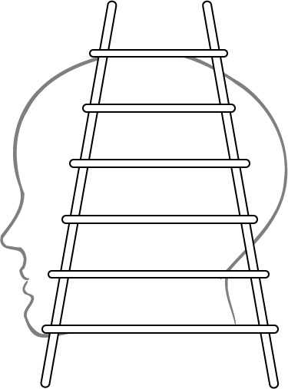
Take Charge of Your Thinking…
I take
ACTION
based on my beliefs
I adopt
BELIEFS
about the world
The Reflective Loop
I draw
CONCLUSIONS
I make
ASSUMPTIONS
based on the meanings I added
I add
MEANINGS
(cultural and personal)
Our beliefs affect what data we select next time
I select
“DATA”
from what I believe
Observable
“DATA” and EXPERIENCES
(as a videotape recorder might capture it)

Slide 30
Reacting vs Responding
Reacting – We react when we are not in control of our lives.
Responding – We respond when we accept responsibility for our own actions.

Slide 31
From Reacting to Responding
This is a bad idea – it won’t work and our data base is fine as it is anyway
I’m not totally convinced but let’s explore the idea more as it may mean improvements
How am I supposed to make this happen in so little time – I have a day job too!
This clearly needs to be done but I’m going to need guidance on prioritising it
The donors won’t like this approach we’ll lose them and never get them back and then how will we sustain funding for future programmes?
I’m concerned about how the donors might respond so let me explore the idea more as it may mean more opportunities

Slide 32
Ways to Reduce impact of Ambiguity
Control your thinking
Connect with your feelings
Be expressive
Manage your responsibilities

Slide 33
The Four Modes of Behaviour
Aggressive I win – You lose | Assertive I win-You win
Depressive I lose – You lose | Passive I lose – You win
Notes:
Assertiveness – the OK Corral. Links back to the Conflict Styles model.

Slide 34
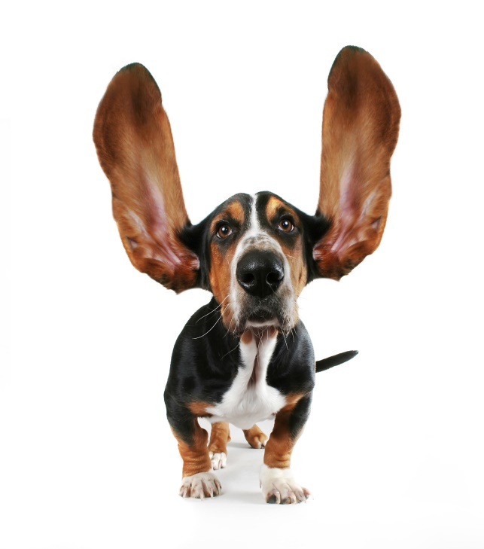
The Three Steps to Assertiveness
Notes:
Take them through the process followed by some additional techniques on the next slide.

Slide 35
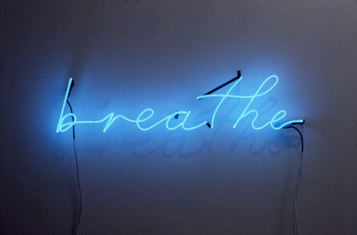
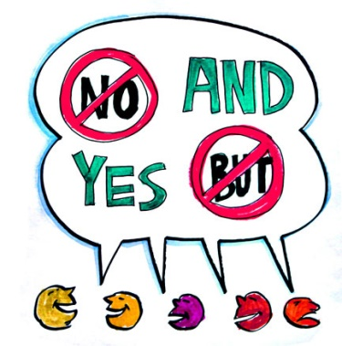
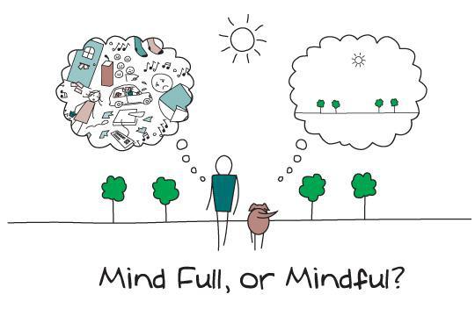
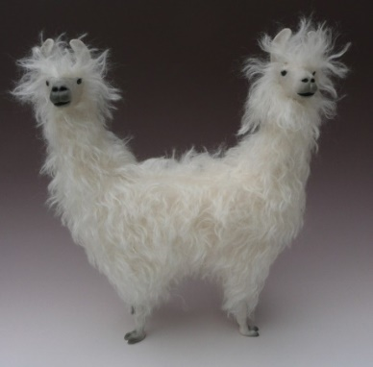
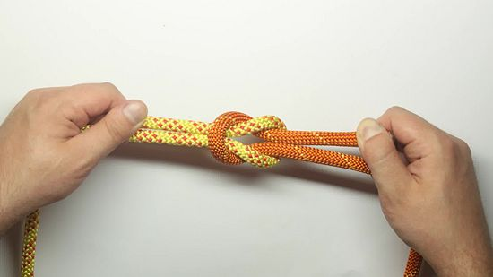
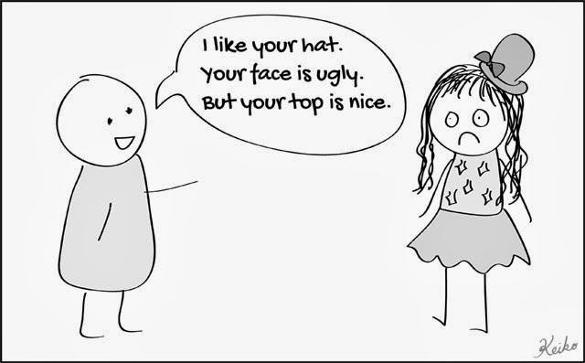
Positive, Problem Solving Approach

Slide 36
The session
What is it?
What’s in it for you to be mentally tough?
What does it look like?
Creating the right environment
When does it come in handy?
How to switch off when you need to

Slide 37
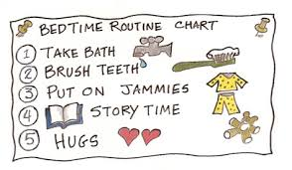
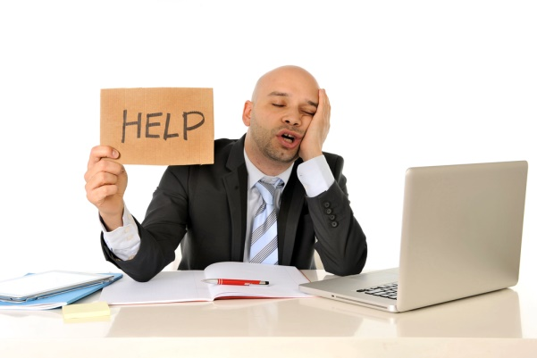
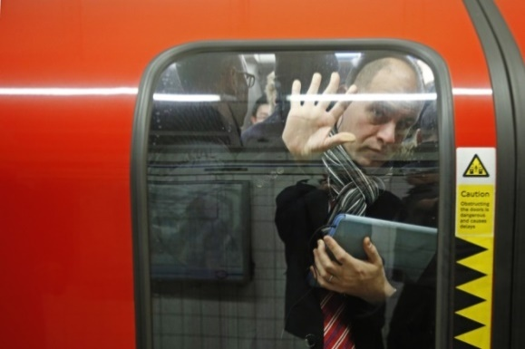
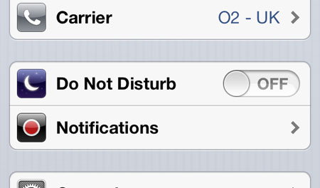
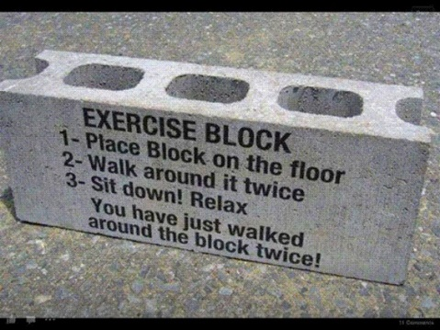
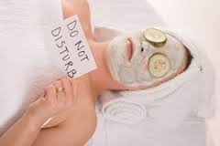
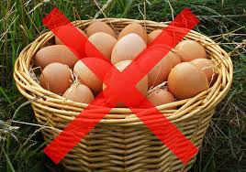
How to switch off when you need to

